Slide 1
Machine Learning
Quiz # 1

Slide 2
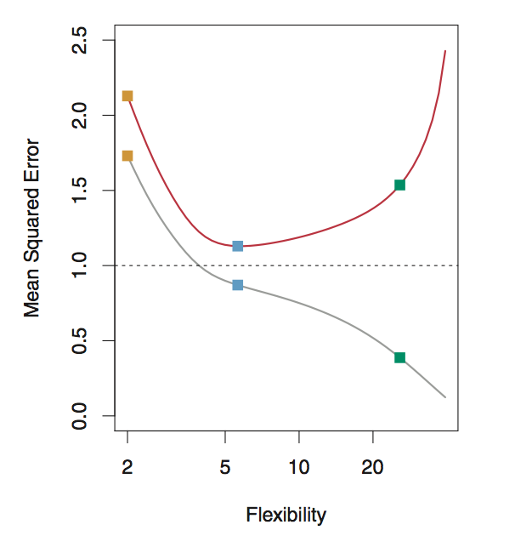
Question 1
1 minute
In the figure below, grey curve represents the training MSE, and red curve represents the test MSE. What does the black dashed line represent?
Notes:
Minimum possible test MSE – 1 Point

Slide 3
Question 2
1 minute
The test MSE (red curve) never goes below the black dashed line. (True/False) – why?
Notes:
True – because it is the minimum possible test MSE – 1 Point

Slide 4
Question 3
1 minute
Why does the test MSE (red curve) has a U-shape?
Notes:
The U-shape is the result of two competing properties: Bias and Variance.
As we increase the flexibility of a class of methods, the bias tends to initially decrease faster than the variance increases. Consequently, the expected test MSE declines. However, at some point increasing flexibility has little impact on the bias but starts to significantly increase the variance.
Total 2 Points – Give 1 point if they just say “because of Bias and Variance”.

Slide 5
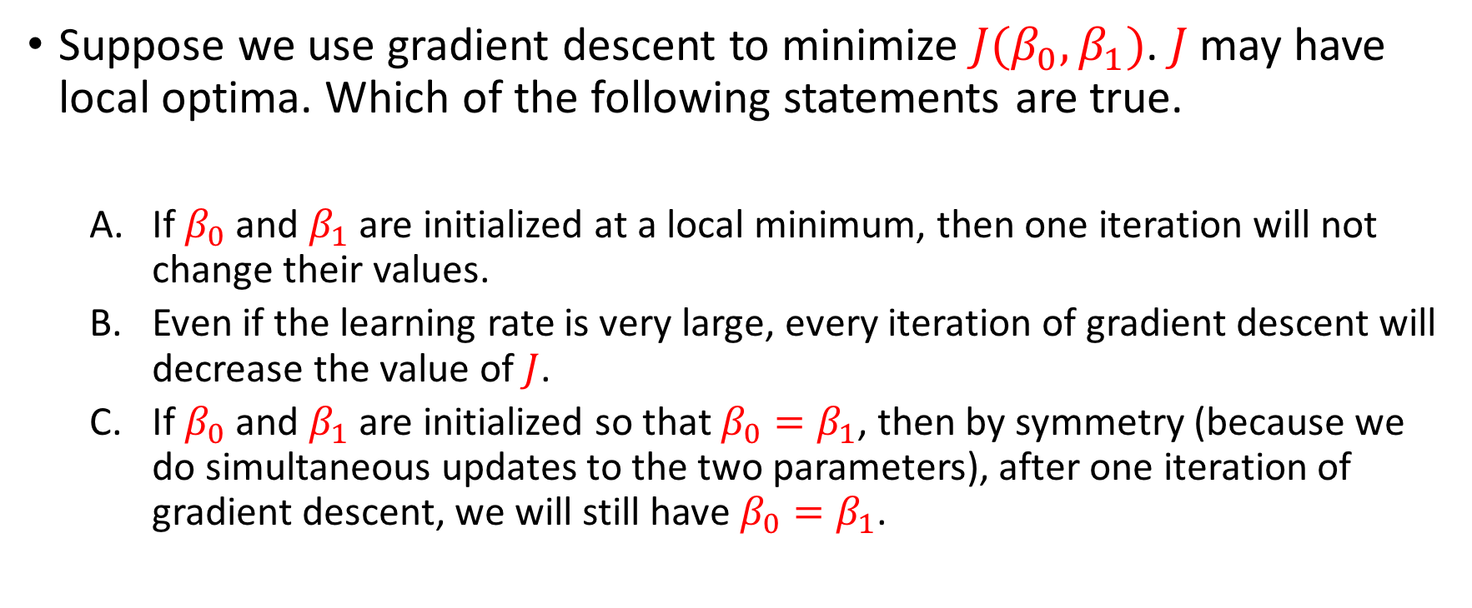
Question 4
2 mins
Suppose we use gradient descent to minimize ${J(β}_{0},β_{1})$. $J$may have local optima. Which of the following statements are true.
If $β_{0}$ and $β_{1}$are initialized at a local minimum, then one iteration will not change their values.
Even if the learning rate is very large, every iteration of gradient descent will decrease the value of $J$.
If $β_{0}$ and $β_{1}$ are initialized so that $β_{0}=β_{1}$, then by symmetry (because we do simultaneous updates to the two parameters), after one iteration of gradient descent, we will still have $β_{0}=β_{1}$.
Notes:
A (True) -- At a local minimum, the derivative (gradient) is zero, so gradient descent will not change the parameters
B (False) -- If the learning rate is too large, one step of gradient descent can actually vastly "overshoot" and actually increase the value of the cost function
C (False) – The updates to intercept and slope are different (even though we're doing simultaneous updates), so there's no particular reason to update them to be same after one iteration of gradient descent.
1 Point – (if they selected only A) otherwise 0

Slide 6
Question 5
2 mins
Assume you fit a regression model to predict house prices from square feet based on a training data set consisting of houses with square feet in the range of 4000 and 5000. In which interval would we expect predictions to do the best? Why?
[0, 2000]
[3000, 4000]
[4000, 5000]
Notes:
C – Machine learning models work well on the training data (things that they have seen) than the test data (things that they have not seen). Since the training was done in the range of 4000 and 5000, C is the correct answer –
1 Point [Even if they just say “because it is the training data” or something equivalent]

Slide 7
Question 6
2 mins
A hypothesis test was performed using the t-test. Using the observed t-statistic, a p-value of 0.002 was computed.
What does this p-value mean in terms of probability?
Will you accept or reject the null hypothesis?
Notes:
This p-value means that there is only 2% probability of getting this t-value in the absence of any relationship between predictor and response.
We reject the Null Hypothesis because the p-value is small.
2 Points (1 point each) – For the first case, they must explain in terms of probability not just simple say that “it means the null hypothesis is false”

Slide 8
Question 7
5 mins
Your friend in the U.S. gives you a simple regression fit for predicting house prices from square feet.
The estimated intercept is -44850 and the estimated slope is 280.76.
You believe that your housing market behaves very similarly, but houses are measured in square meters. So you decide to use this model to make predictions for your market
To make predictions for inputs in square meters,
what intercept must you use? Why?
What slope must you use? Why?
Hint: there are 0.092903 square meters in 1 square foot.
Notes:
1. Intercept stays the same (i.e. -44850) because intercept is measured in the unit of the response variable, which is the house price in this case. And since the response variable is the same in both cases, the intercept remains the same.
2. Slope is measured in terms of (unit response/unit predictor). For first market, it is (unit price/unit size) = (unit price/square feet). For the second market it should be (unit price/square meter). Thus for your market you must use a slope of 280/(0.092903) = 3022.076
6 Points (3 points each) – Correct answers with proper justification is required.

Slide 9
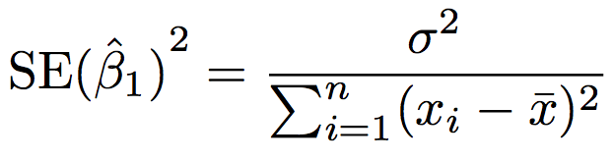

Question 8
3 mins
The variability in the estimated slope $β_{1}$ is smaller when the x-values are more spread out. (True/False) – Why?
Notes:
True
Take a look at the equation that I put above. This tells us that the standard error (amount of variability in the estimate of the slope) is smaller when the x-values are more spread out; intuitively we have more leverage to estimate a slope when this is the case.
3 Points – Correct answers with proper justification is required.

Slide 10

Question 9
4 mins
Derive the update equation for $β_{1}$ of simple linear regression using gradient descent?
Notes:
3 Points

